Slide 1

Optimising Users, Groups, and Role Management
With Access Control and Workflow Integration
Presented by: Jancy Nandini
Project Title : "AccessFlow: Intelligent Role & Access Management Optimization"

Slide 2

Introduction & Objectives
Introduction
Objectives
Structured user and access governance is paramount in enterprise systems. Mismanagement poses significant risks, including data breaches, operational inefficiencies, and compliance failures.
Streamline Onboarding/Offboarding
Automate user provisioning and de-provisioning processes.
Automate Access Control
Implement policies for dynamic access assignment and revocation.
Implement Role-Based Workflows
Establish approval mechanisms for role assignments.
Enforce Least Privilege
Ensure users only have access essential for their duties.

Slide 3
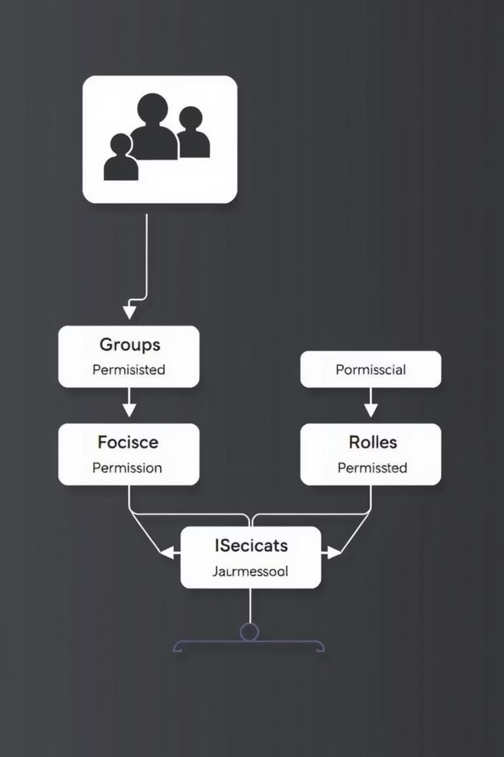




Core Concepts
Users
Individuals with distinct identities accessing system resources.
Groups
Collections of users sharing common access requirements, simplifying management.
Roles
Predefined sets of permissions (e.g., Create, Read, Update, Delete) assigned to users or groups.
Access Control
Mechanisms dictating authorised actions users or groups can perform on resources.

Slide 4
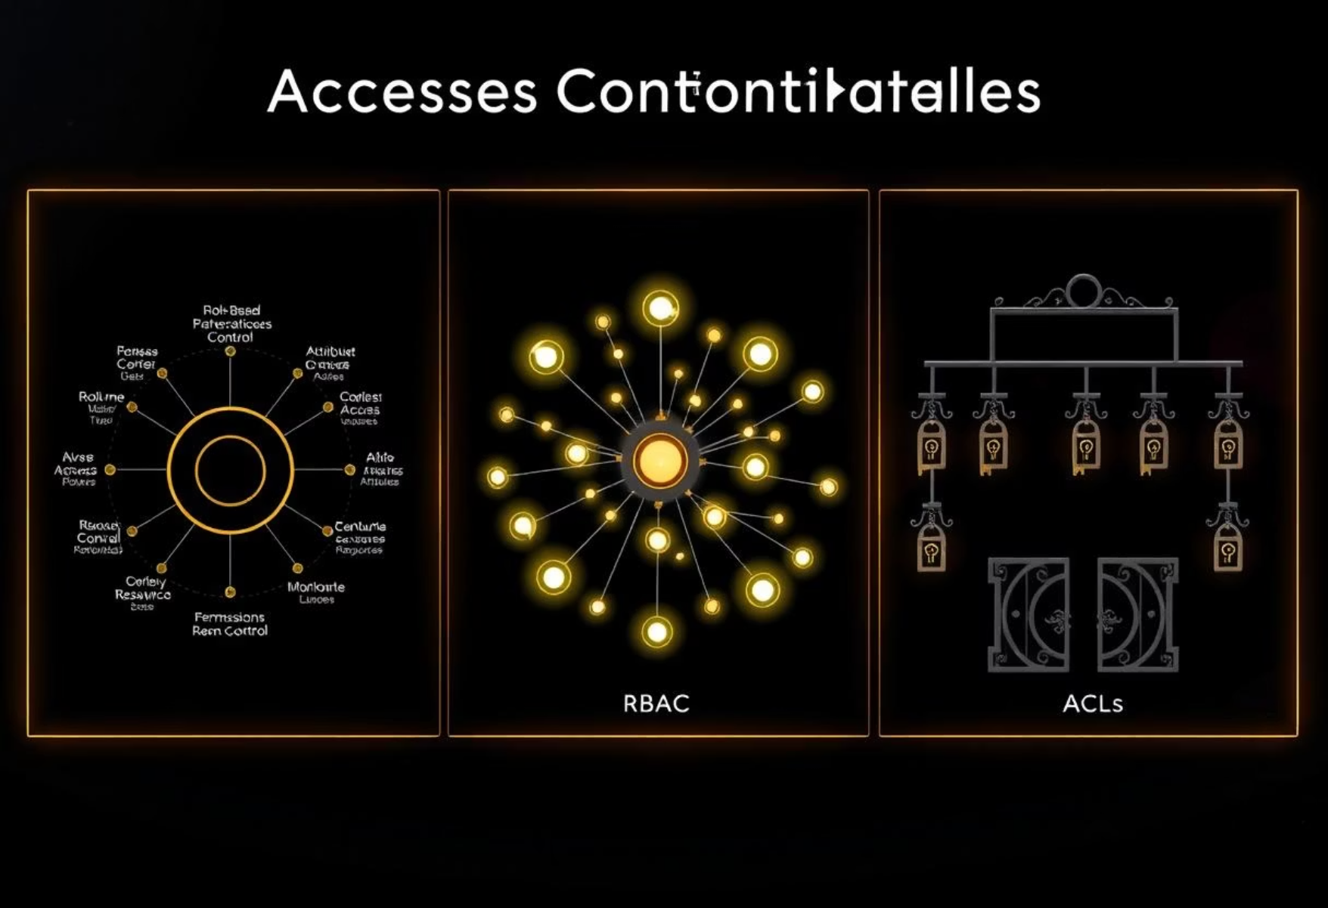
Access Control Models
Selecting the appropriate access control model is crucial for robust security and efficient administration. Each model offers distinct advantages based on an organisation's specific needs and complexity.
Role
Read
Write
Delete
Admin
User
✅
❌
❌
❌
Admin
✅
✅
✅
✅
RBAC
Access is granted based on assigned roles within the organisation.
ABAC
Access decisions are dynamic, based on user, resource, and environmental attributes.
ACLs
Permissions are explicitly defined for individual objects or resources.

Slide 5
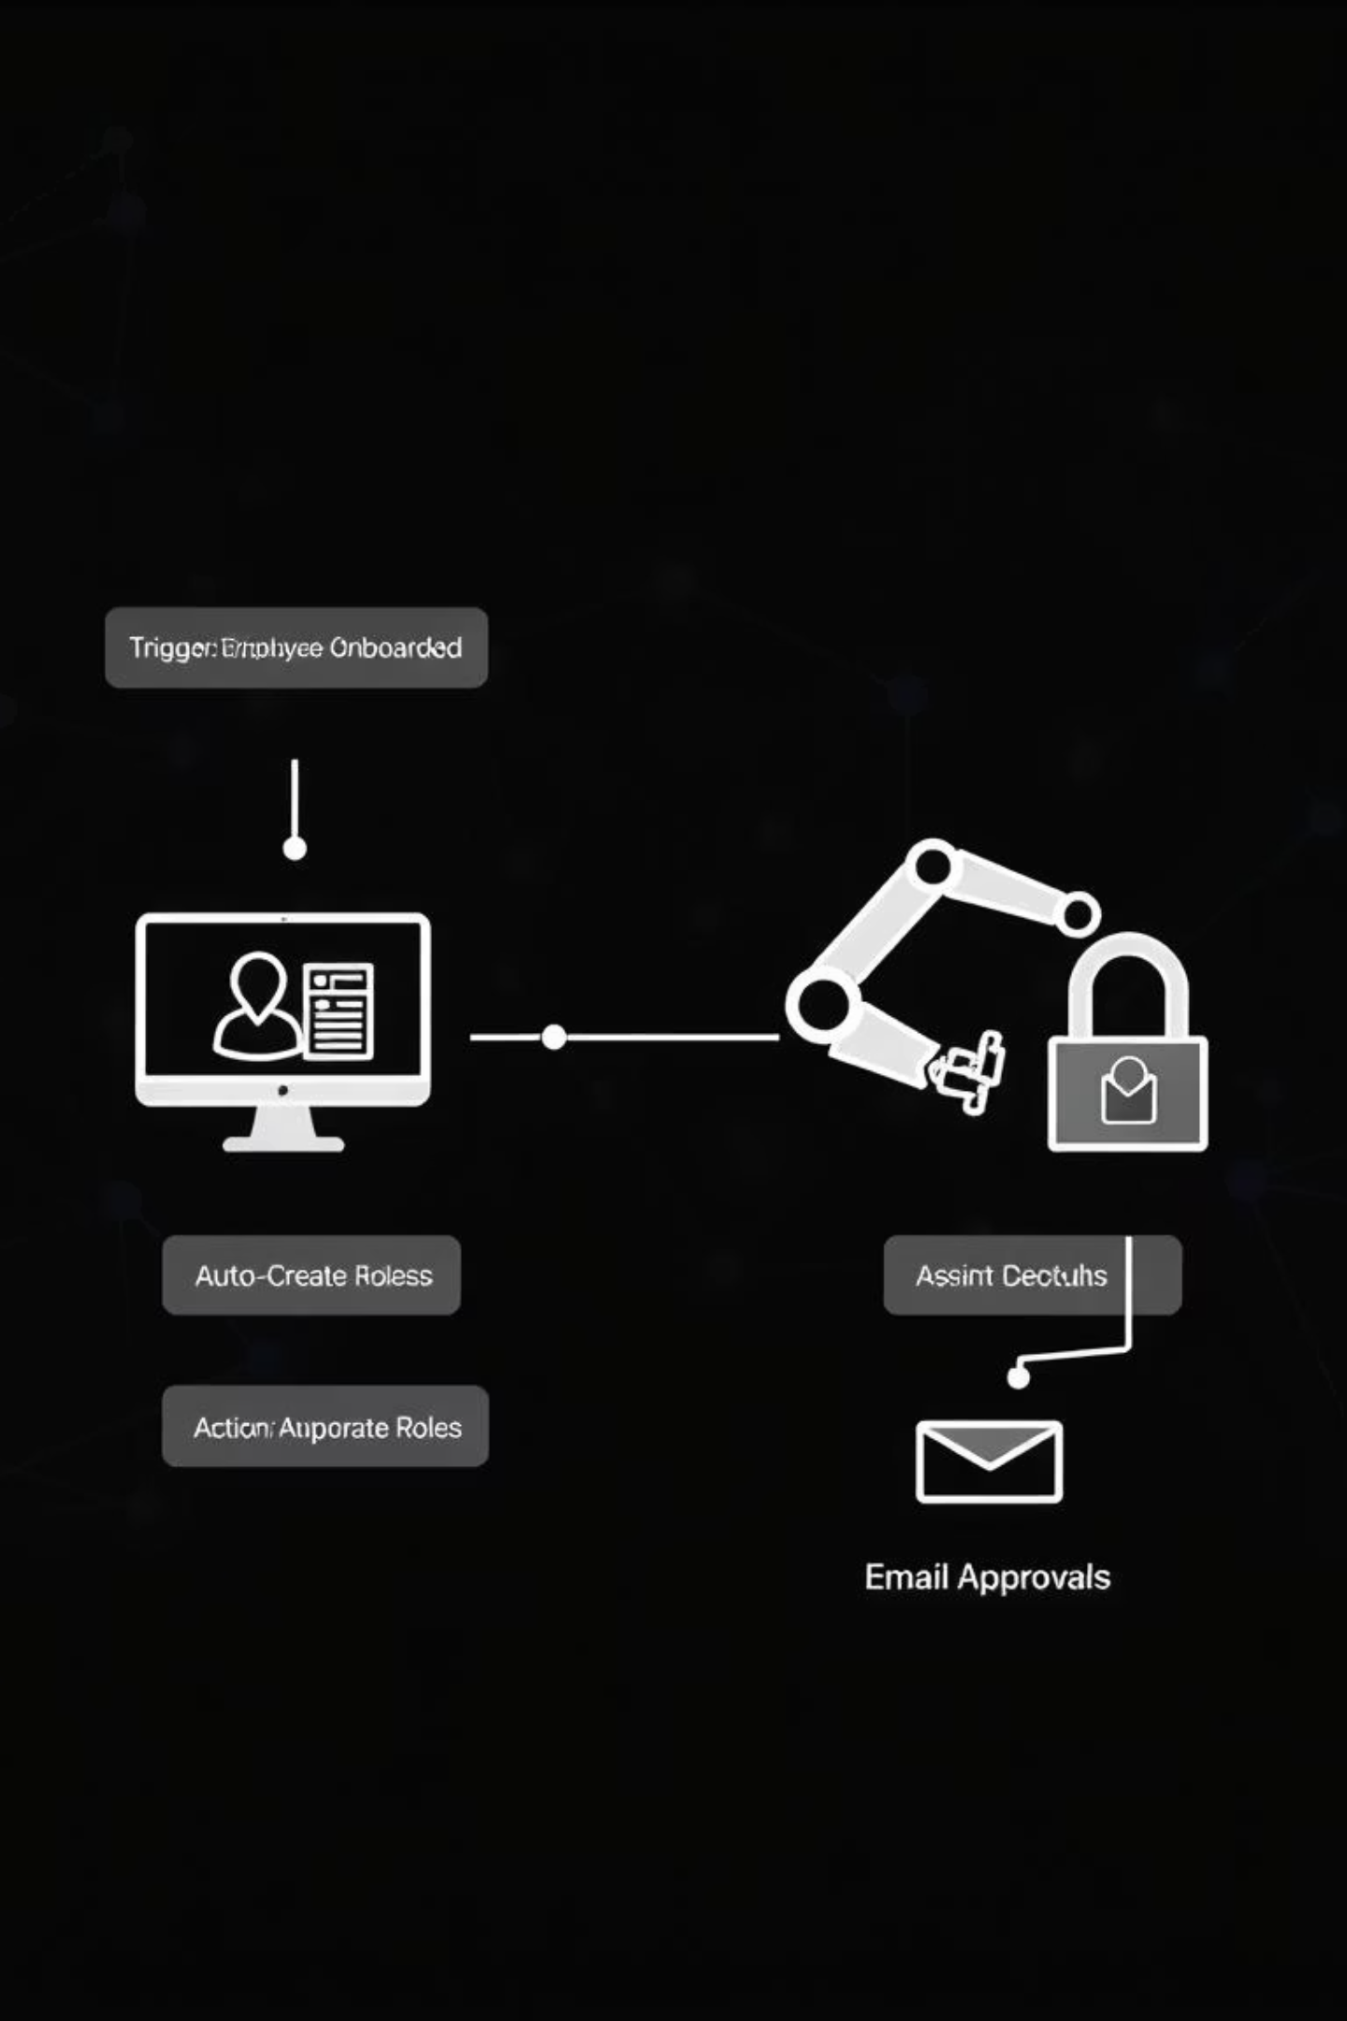
Workflows in Action
1
Automated Workflows
Workflows orchestrate and automate key processes such as role approval and escalation, auto-removal of dormant access, and reassignment upon role changes, ensuring efficiency and compliance.
2
ServiceNow Flow Example
A typical ServiceNow flow might trigger upon employee onboarding, automatically creating a user account, assigning initial roles, and routing approval emails to relevant managers.
3
Key Workflow Tools
Tools such as Business Process Model and Notation (BPMN) platforms, ServiceNow Flow Designer, and custom scripting facilitate the design and implementation of these automated processes.

Slide 6





Optimisation & Automation Techniques
Dynamic Assignment
Roles and groups are dynamically assigned based on changing user attributes or system events.
Role Cleanup
Periodic review and minimisation of roles to prevent "role explosion" and reduce attack surfaces.
Automated Reviews
Scheduled access review cycles ensure entitlements remain appropriate and compliant.
Compliance Tracking
Workflow-driven tracking and reporting of access changes for audit readiness and regulatory adherence.

Slide 7
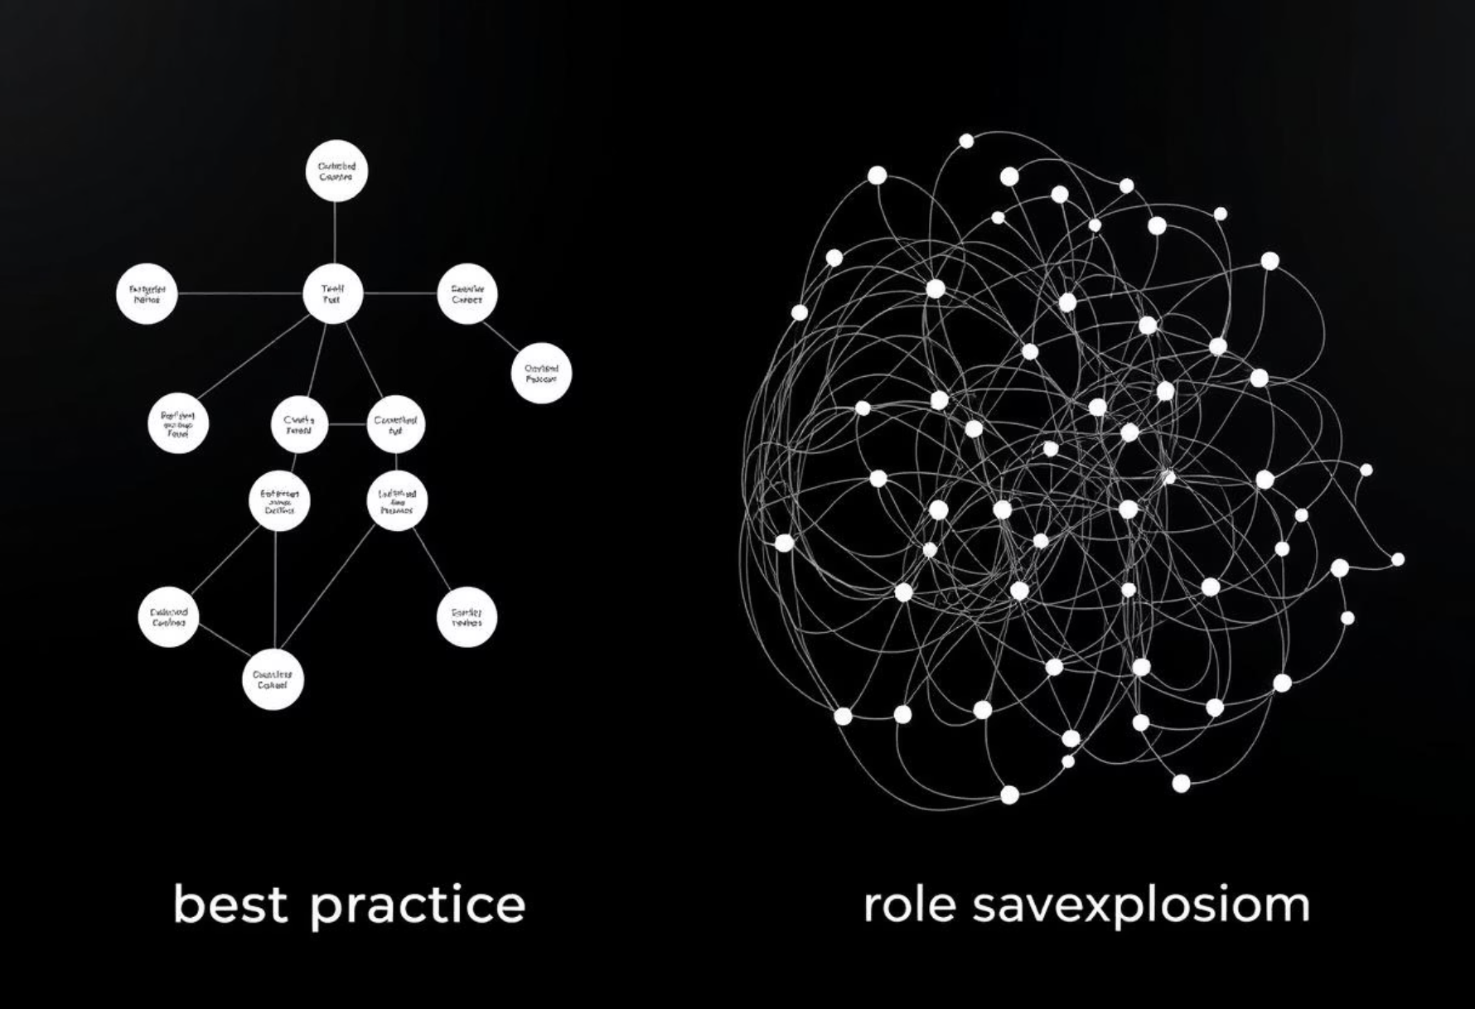








Use Case, Challenges & Best Practices
Challenges
Role explosion: Uncontrolled proliferation of roles.
Inactive users: Dormant accounts posing security risks.
Audit trail maintenance: Ensuring comprehensive logging for compliance.
Best Practices
Regular access reviews: Periodically validate user entitlements.
Clearly defined roles: Create concise, purpose-driven roles.
Least privilege: Grant minimum necessary access for tasks.
Onboarding
New IT staff are provisioned.
Auto Role Assignment
Roles assigned based on job function.
Access Approval
Managerial approval workflows initiated.
Workflow Logging
All access changes are logged for audit.

Slide 8
Conclusion & Future Scope
90%
75%
80%
Enhanced Security
Operational Agility
Compliance Readiness
Reduced vulnerability from access misuse.
Faster user provisioning and de-provisioning.
Robust audit trails and policy enforcement.
Future Scope
Q&A / Thank You!
AI-driven role suggestions: Leveraging machine learning for optimal role design.
Cross-platform IAM integration: Unified identity and access management across diverse environments.
Advanced ABAC models: More granular and dynamic access decisions.

